Slide 1
Assignment - 6
Agile Software Engineering and Devops
SRS Document for Machine Learning
System Test Plan for Machine Learning
code

Slide 2
INTRODUCTION :-
What is Artificial Intelligent :
The human intelligence inside the computer is called Artificial Intelligence.
What is Machin learning
Making the machines to learn is called Machine Learning.
There are 3 types:
1.Supervised learning
2.Unsupervised learning
3.Reinforcement learning
1.Supervised learning – leaning from Someone.
2.Unsupervised learning – leaning by our own.
3.Reinforcement learning – It involves rewards and penalty.

Slide 3
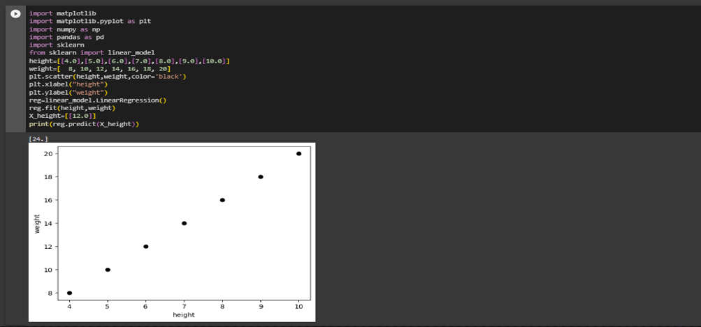
Regression is used for continuous data prediction.
Classification - yes/no , true/false , this/that.
What is linear Regression.
Linear regression is a statistical modeling technique used to establish a relationship between a dependent variable and one or more independent variables.
Code of linear Regression

Slide 4
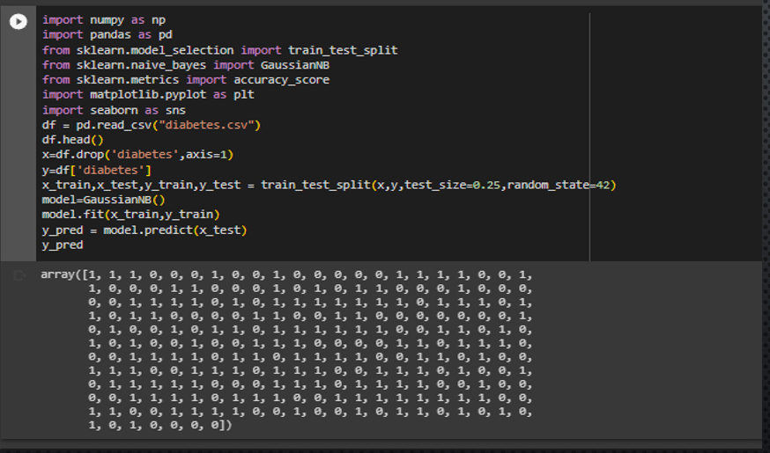
Naive Bays
Naive Bayes is a probabilistic classification algorithm based on Bayes' theorem with an assumption of independence between features.

Slide 5
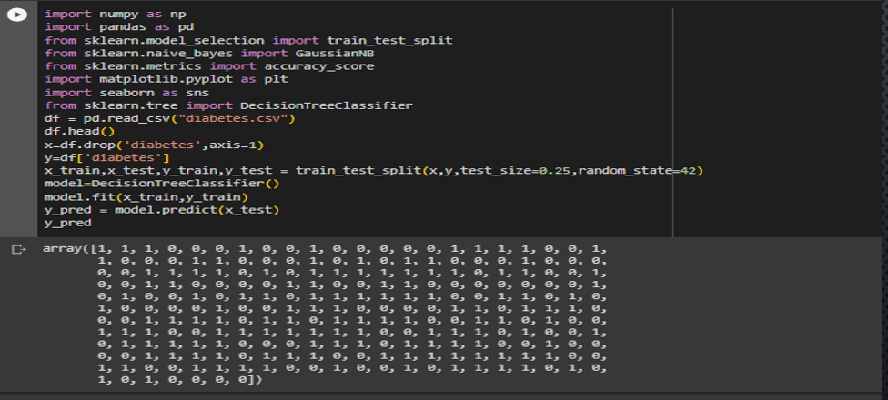
Decision tree - A decision tree is a flowchart-like structure that represents a series of decisions and their potential consequences or outcomes. It is a supervised machine learning algorithm that can be used for both classification and regression tasks.
Code :

Slide 6
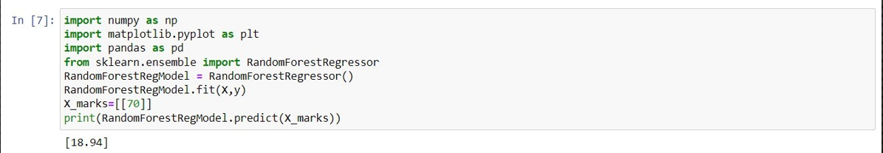
Random Forest - Random Forest is an ensemble machine learning algorithm that combines the predictions of multiple individual decision trees to make more accurate and robust predictions.
Code :

Slide 7
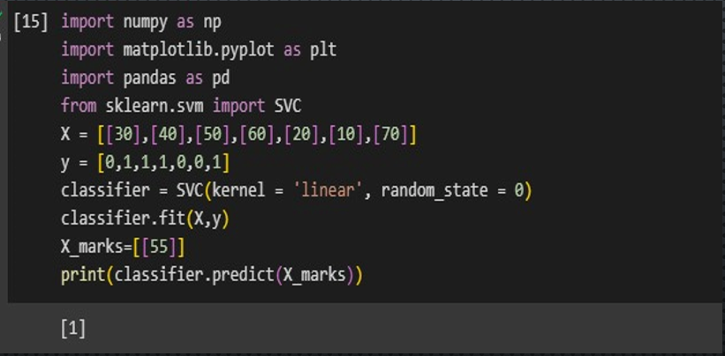
SVM - Support Vector Machines (SVM) is a supervised machine learning algorithm used for both classification and regression tasks. SVMs are particularly effective in solving complex problems with high-dimensional feature spaces.
Code –

Slide 8
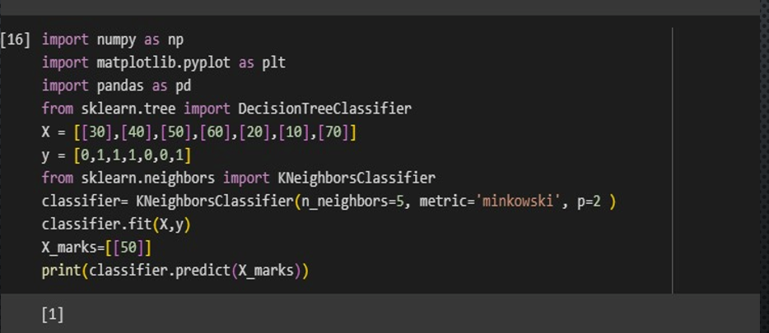
K-Nearest Neighbors (KNN) is a supervised machine learning algorithm used for classification and regression tasks. It is a non-parametric algorithm, meaning it does not make any assumptions about the underlying distribution of the data.
Code –

Slide 9
SRS FOR DIABETES DETECTOR
Test Plan Identifier: Diabetes detector
Introduction:
this test plan is written to the system testing for the Diabetes detection
Test Items:
the following test items will be tested in this plan:
-accuracy of Diabetes detection using blood pressure and glucose level.
Features To Be Tested:
the following features will be tested as a part of system testing:
- Glucose level
- Blood-pressure level
Features Not to Be Tested: Not applicable

Slide 10
Approach:
Our diabetes detection project provides accurate output whether a person is having
diabetes or not by considering the blood pressure and glucose level in the blood, this
will be done by comparing of the data.
Item Pass/Fail Criteria:
Every test case will have input and processing and expected output. If the output is
according to the expected output, it is pass or else it is failed.
Suspension Criteria and Resumption Requirements:
During the system testing if the number of defects is more the test team will suspend
the testing activities and after all the defects are fixed by the development team the
test team will resume the testing again.

Slide 11
Test Deliverables:
- Test plan
- Test case
- Test script
- Test scripts automation
Testing Tasks:
- Setting up the test system with the product called diabetes detector.
- Execute all the test case + test scripts
- Generate reports and share it with development team.

Slide 12
Environmental Needs:
- Pentium 17 machines with windows 10
- Product software
- Report of people’s medical data
- A team of people who know very well about medical science.
Responsibilities:
The responsibility of the system teste team is to execute all the test scripts and give
or generate the report, which contains how many test scripts are passed or failed.
Staffing And Training Needs: three engineers are required
Schedule: one month
Risks And Contingencies: Not applicable

Slide 13
Approvals:
The test plan has to be approved by the:
- project manager
- Developers
- customer

Slide 14
THANK YOU

